Slide 1
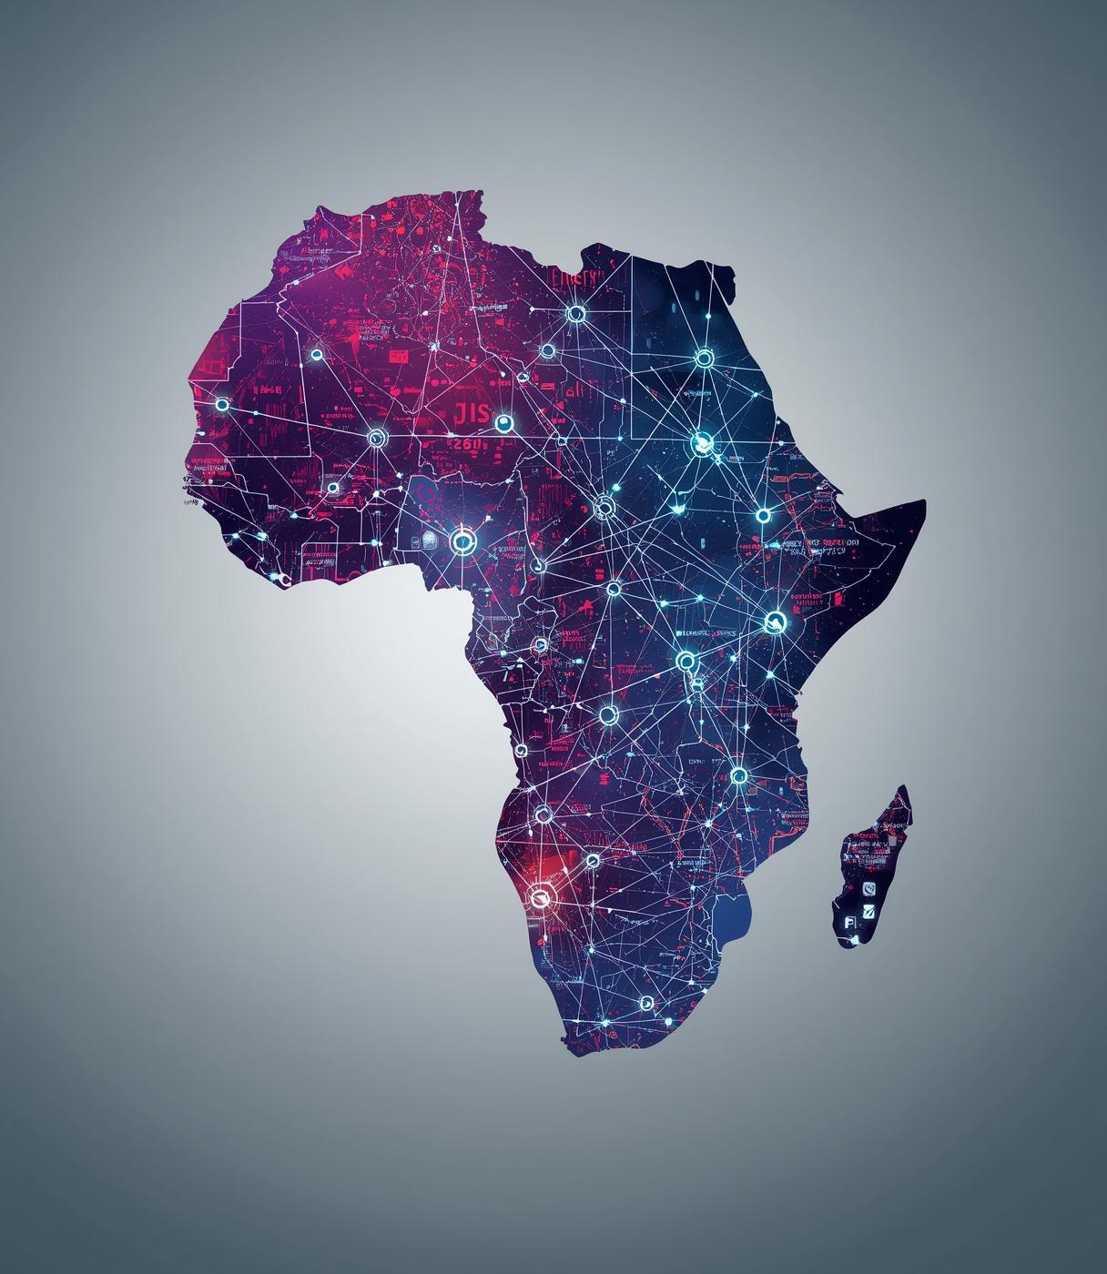
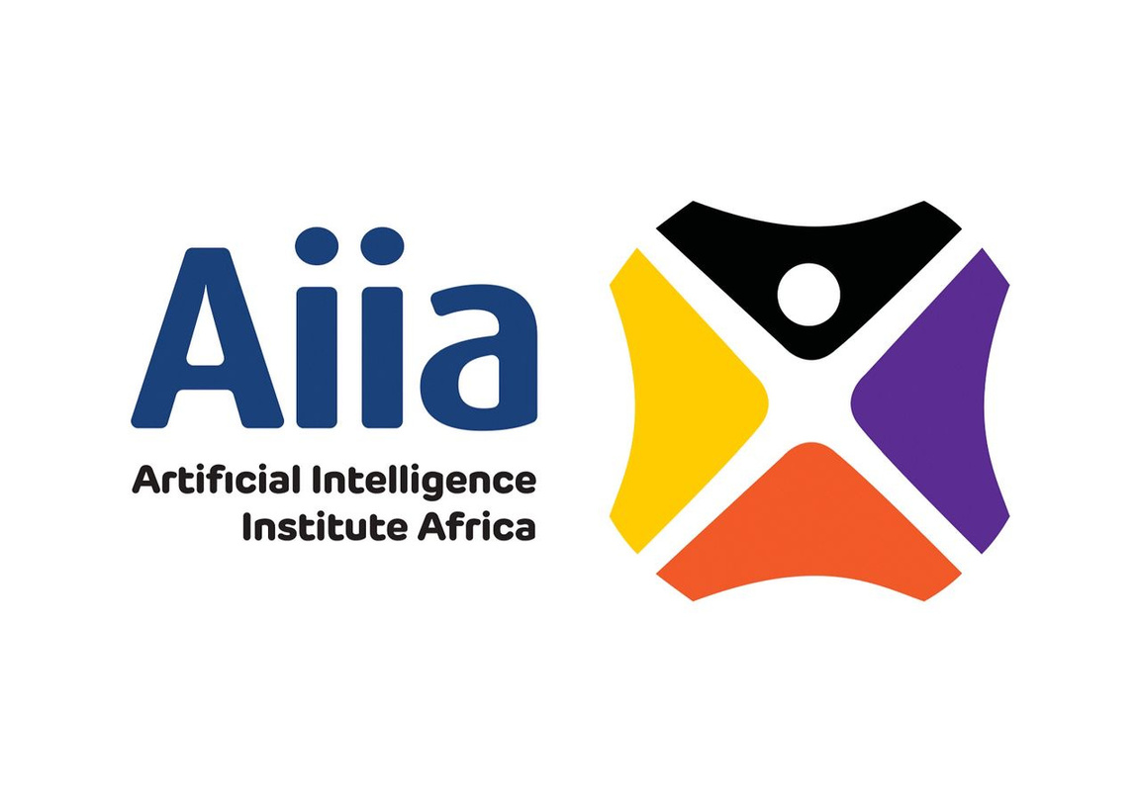
AIIA
High-Impact Investment
Presented by the Artificial Intelligence Institute Africa

Slide 2

Minerals Processing & Beneficiation (Lithium)
Lithium Beneficiation Opportunities
Economic Growth
Market Potential
The lithium beneficiation facility is poised to significantly drive economic growth in Zimbabwe by creating skilled employment opportunities and stimulating industrialization in the region's resource sector.
Investment- USD50-100m/IRR 10-25%/Payback 4-6years/ Risk medium-high
The projected market for lithium products in Zimbabwe ranges from USD 1-2 billion SADC USD 10bn+, positioning the country as a key player in the regional battery minerals market with substantial investment opportunities.

Slide 3
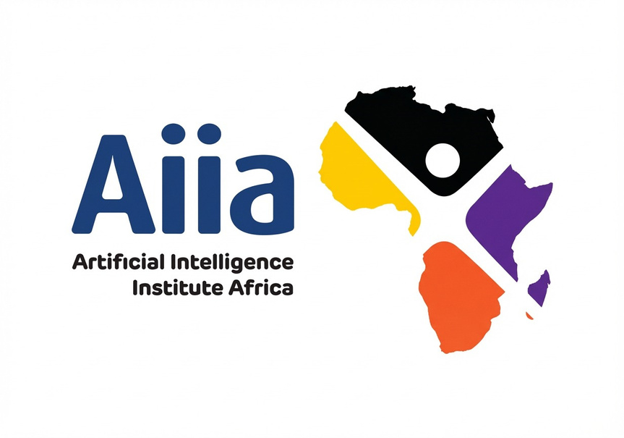
Renewable Energy & Power Infrastructure
Solar power and storage innovations
Energy Security
Market Potential
Implementing utility-scale solar projects ensures energy security for critical sectors like industry and healthcare, significantly reducing reliance on unstable energy sources and promoting economic growth.
Investment: USD 20–80m | IRR 12–18% | Payback 6–8 yrs | Risk: Medium
With over 1,000MW energy gap in Zimbabwe, the renewable energy market presents a substantial investment opportunity, projected at USD 20 billion across the Southern African Development Community (SADC).

Slide 4
Beef, Seed Systems & Agro-Processing
Integrated value chain opportunities
Beef Value Chain
Certified Seeds
Developing an integrated beef value chain will enhance food exports, generate rural jobs, and contribute to import substitution, positively impacting local economies and food security.
Investment: USD 15–50m | IRR 14–20% | Payback 5–7 yrs | Risk: Medium
The introduction of certified seeds will strengthen agricultural productivity, enabling farmers to achieve higher yields and improved quality, which will further boost the agro-processing industry in Zimbabwe.

Slide 5
Digital & AI Infrastructure & Applications for Africa
Transforming Africa's technological landscape
Data Centres
Digital Platforms
AI-ready data centres are critical for enhancing data processing efficiency, enabling faster decision-making, and supporting the growing demand for digital services across various sectors in Africa.
Investment: USD 20–60m | IRR 20–30% | Payback 3–5 yrs | Risk: Medium
Regional digital platforms facilitate seamless connectivity and collaboration among businesses, driving innovation and economic growth while improving access to essential services for communities throughout the continent.

Slide 6
Fintech, Digital Banking & Emerging Financial Platforms
Empowering digital financial solutions
Cross-Border Payments
Digital Banking
Implementing efficient cross-border payment systems can significantly reduce transaction costs, enhance trade efficiency, and improve financial accessibility for small and medium enterprises across the region.
Investment: USD 10–40m | IRR 22–35% | Payback 3–4 yrs | Risk: Medium–High
The rise of digital banking platforms in Africa offers unbanked populations greater access to financial services, promoting economic inclusion and driving significant growth within the fintech sector.
Market: Zimbabwe USD 200m | SADC USD 30bn transaction value

Slide 7
SME Enablement & Industrial Platforms
Enhancing industrial platforms for growth
Digital Platforms
Industrial Parks
Digital SME platforms facilitate business connectivity and collaboration, enabling small enterprises to access resources, share best practices, and optimize their operations for increased productivity and growth.
Investment: USD 10–30m | IRR 15–20% | Payback 6–8 yrs | Risk: Medium
Establishing industrial parks promotes job creation and economic activity by providing businesses with the necessary infrastructure and resources to scale, driving local development and fostering entrepreneurship.
Market: Zimbabwe USD 300m | SADC 50m SMEs

Slide 8
Climate-Resilient, Environmental & Green Projects
Investing in a sustainable future
Carbon Credits
Green Infrastructure
Carbon credits offer opportunities for investors to engage in global carbon markets while promoting climate resilience, generating revenue through sustainable practices that contribute to reducing greenhouse gas emissions.
Investment: USD 10–40m | IRR 12–18% | Payback 7–10 yrs | Risk: Medium–High
Developing green infrastructure fosters environmental sustainability while supporting economic growth, creating jobs, and enhancing community resilience through initiatives like renewable energy projects and climate-aware urban planning.
Market: Zimbabwe 5–10m credits | Africa USD 50bn by 2050

Slide 9
Specialized Healthcare & Medical Infrastructure
Enhanced Medical Infrastructure in Africa
Healthcare Access
Diagnostic Excellence
Regional specialised hospitals will significantly improve healthcare access, reducing the need for medical tourism and enhancing local treatment capabilities across Zimbabwe and surrounding countries.
Investment: USD 30–80m | IRR 13–18% | Payback 7–9 yrs | Risk: Medium
Establishing diagnostics centres will foster diagnostic excellence, enabling quicker and more accurate medical evaluations, ultimately improving treatment outcomes and health management in the region.
Market: Zimbabwe USD 1bn | SADC USD 5–7bn

